Slide 1
A Walk Through Physics
Ham Sopkins

Slide 2
Taylor Expansions

Slide 3
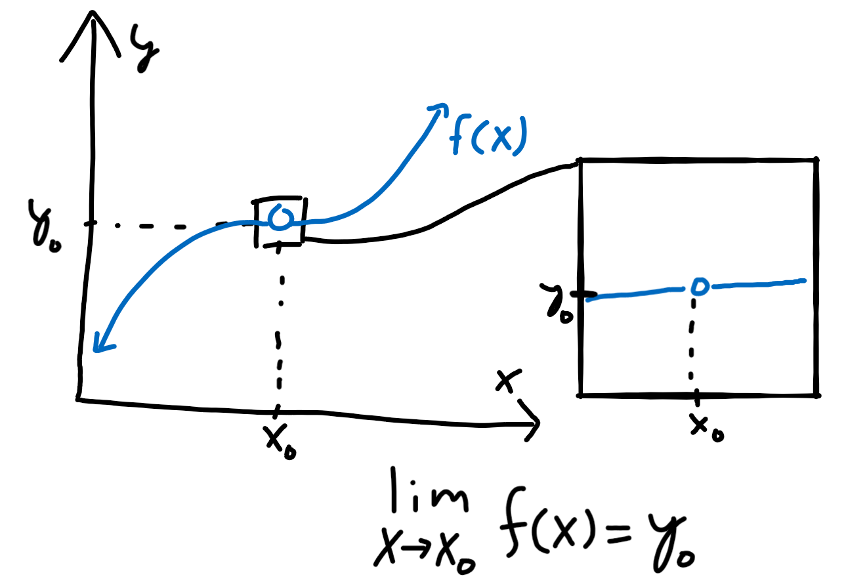
Limits
Let’s take a graph and remove a point from it.
How do we know which point we removed?
We can zoom in and see what the values of nearby points are and deduce that the removed point should be “very close” to the nearby points.
More concretely: we approach the point from both sides of the graph and see the trend very near, but not at, a particular point.
This is the idea behind taking a “limit” of a function.

Slide 4
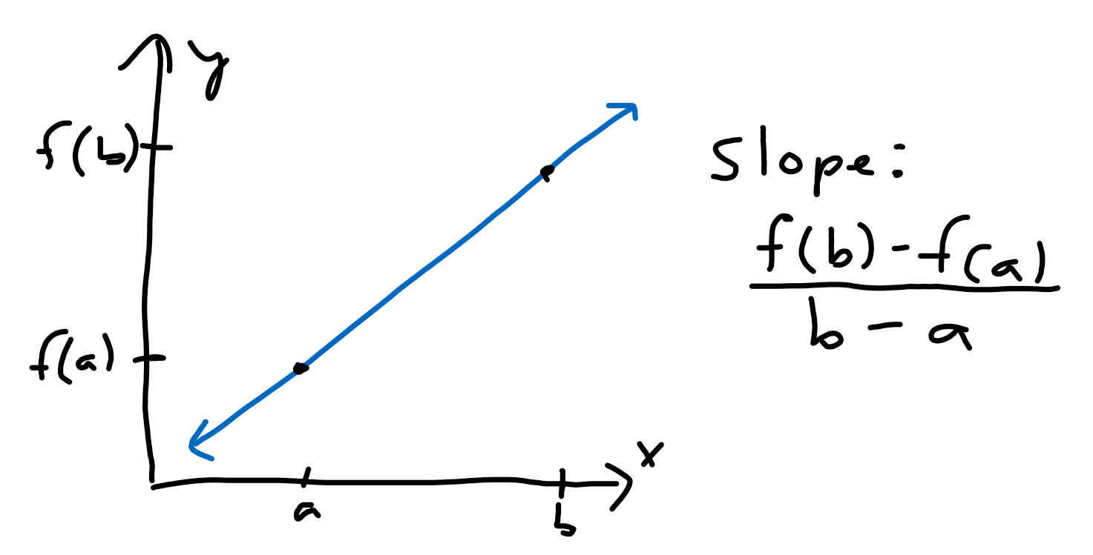
Slopes
We can calculate the “slope” of a line by taking the rise (change in y coordinate) and dividing it by the run (change in x coordinate).
For a line of the form y = f(x), the slope from a point x = a to x = b can be written as the fraction [f(b) - f(a)]/[b - a].

Slide 5
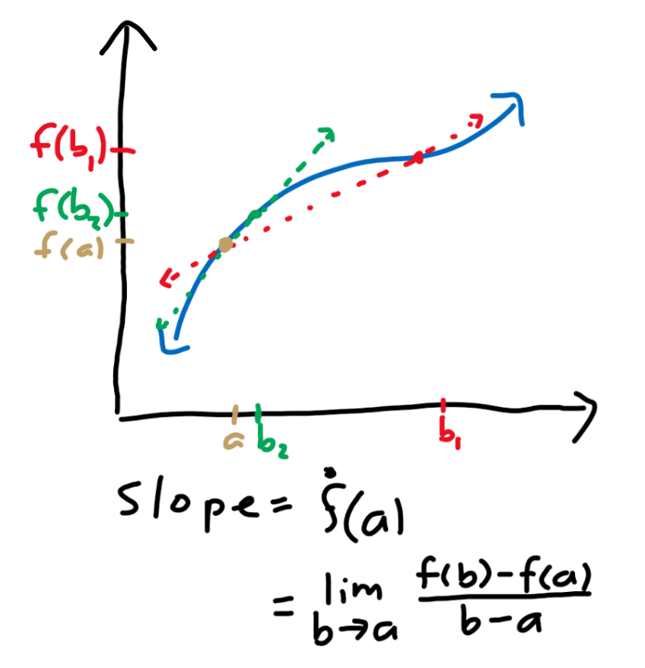
Derivatives
What about the slope for a non-linear curve?
We can approximate the slope at a certain point “a” as the slope of the line that passes through “a” and a nearby point “b.”
As b gets closer to a, our approximation gets better.
If we use our slope formula and take the limit as b approaches a, we get the slope of the curve at a point a.
We call the slope at a the value of the “derivative” of the curve at the point a.

Slide 6
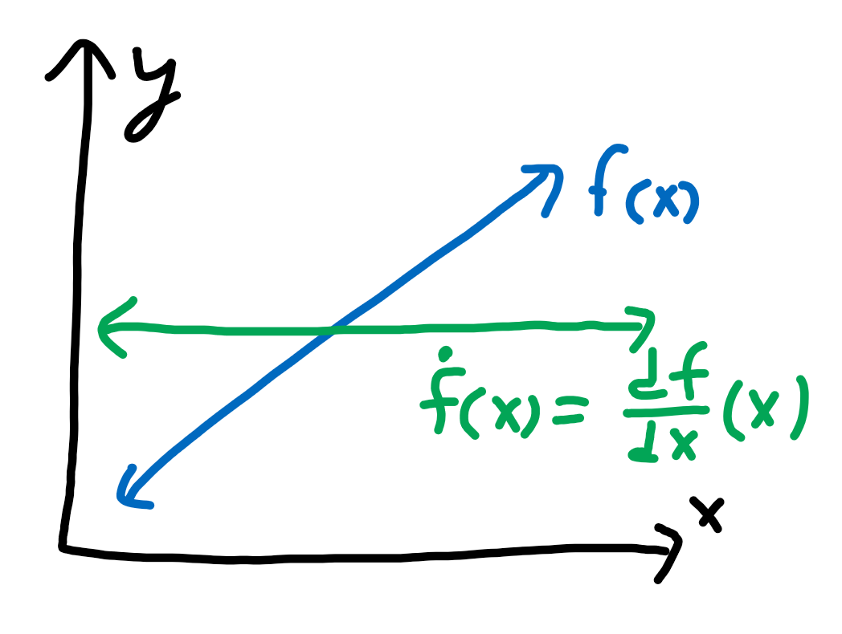
Derivatives as a function
We can plot the value of the derivative at every point to get the derivative as a function, which we denote as dy/dx where d represents a small change in.
Thus, dy/dx represents a small change in y divided by a small change in x, which is rise over run at a very small scale.

Slide 7
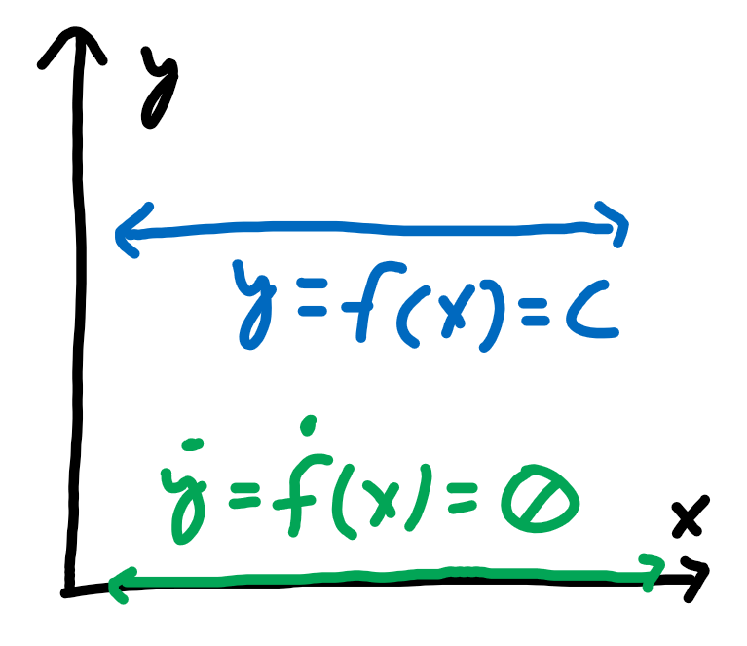
Derivative of a constant
The constant function y = c has a slope of 0 everywhere, so the derivative dy/dx of the function y = c is 0.

Slide 8
Polynomials
A polynomial p(x) is the sum of terms c_{n}x^{n} where c_{n} is some constant and n is a non-negative integer.
In general, we can write a polynomial as the expression p(x) = c₀ + c₁x + c₂x² + . . . + c_{n}x^{n}.

Slide 9
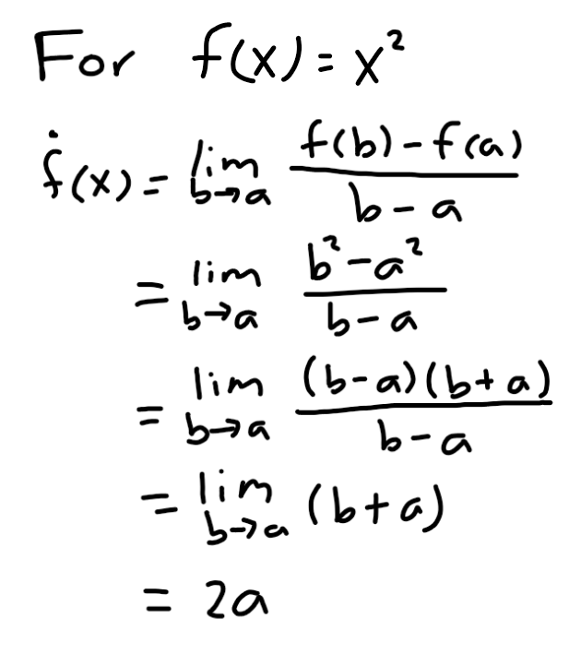
Power rule
What about for a polynomial?
We can do some manipulation of the derivative formula for a polynomial and find that, in general, the derivative of the function y = x^{n} is dy/dx = nx^{n-1} where n is a non-zero integer.

Slide 10
Coefficients of a polynomial
Notice that p(0) = c₀.
Let p’ = dp/dx. Then, p’(x) = c₁ + 2c₂x + 3c₃x² . . ., so p’(0) = c₁.
We can continue taking derivatives to get p’’ = dp’/dx = 2c₂ + 6c₃x + . . . and p’’’ = dp’’/dx = 3c₃.
Thus, p’’(0) = 2c₂ and p’’’(0) = 6c₃ = (3!)c₃.
Let us define p^{(a)} to be the “a”th derivative of the polynomial p(x). In other words, the result when we take the derivative of p(x) “a” times.
Then p^{(a)}(0) represents the value of the function p^{(a)}(x) at x = 0.
In general to find c_{a}, where a is an integer between 0 and n inclusive, we can use the equation c_{a} = p^{(a)}(0)/(a!).

Slide 11
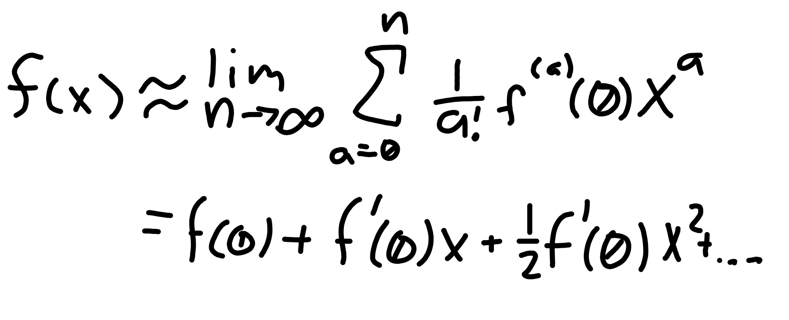
Taylor approximation (at x = 0)
Let us try to approximate a function f(x) as a polynomial p(x). Thus, we treat f as a polynomial.
The polynomial is formed from many “monomial” terms c_{a}xª.
We know c_{a} = f^{(a)}(0)/(a!), so c_{a}xª = [f^{(a)}(0)/(a!)]xª.
We can write out each and every term to get f(x) ≈ f(0) + f’(0)x + [1/2]f’’(0)x² + [1/(3!)]f’’’(0)x³ . . . with more terms.
This is called the Taylor expansion of f(x) at the value x = 0, also known as the Maclaurin series of a function.

Slide 12
Relativity

Slide 13
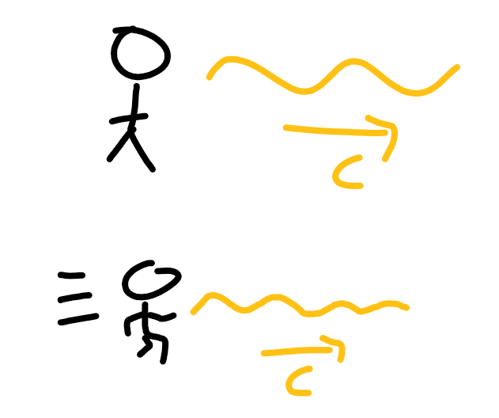
The one constant
The speed of light (in a vacuum) is constant in any reference frame.
That means that a stationary observer and an observer moving at a velocity v will both observe the sleep of light to be constant.
We call the constant “c.”

Slide 14
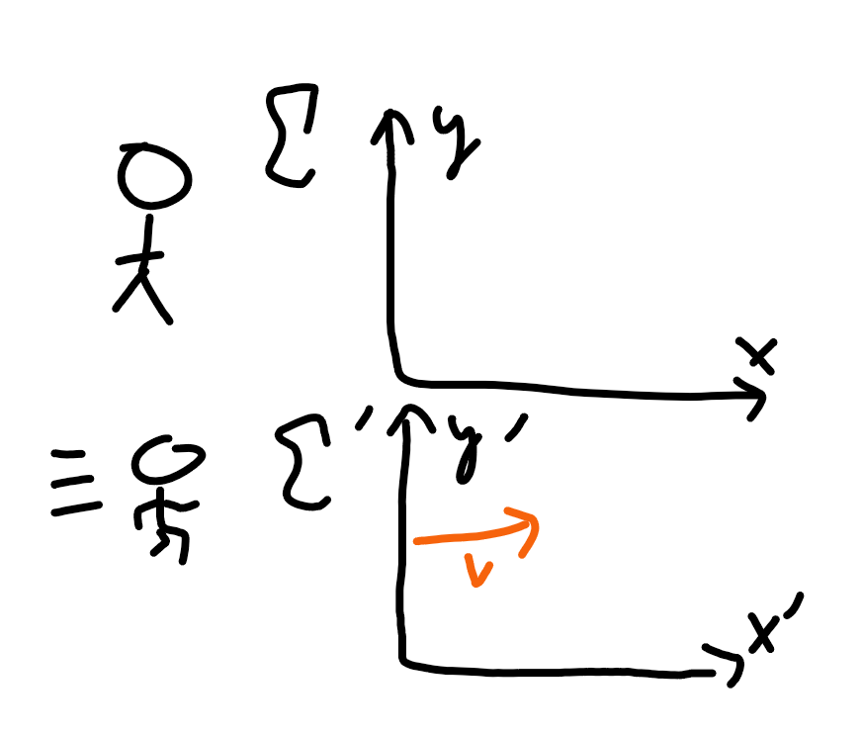
Reference frames
We denote reference frames with the symbol sigma: Σ.
Generally, a moving reference frame is denoted as Σ’ and a stationary one is Σ.
For us, we will define Σ’ to be moving along the positive x’-axis at a constant velocity v compared to Σ where the x and x’ axes are parallel and the y and y’ axes are parallel.

Slide 15
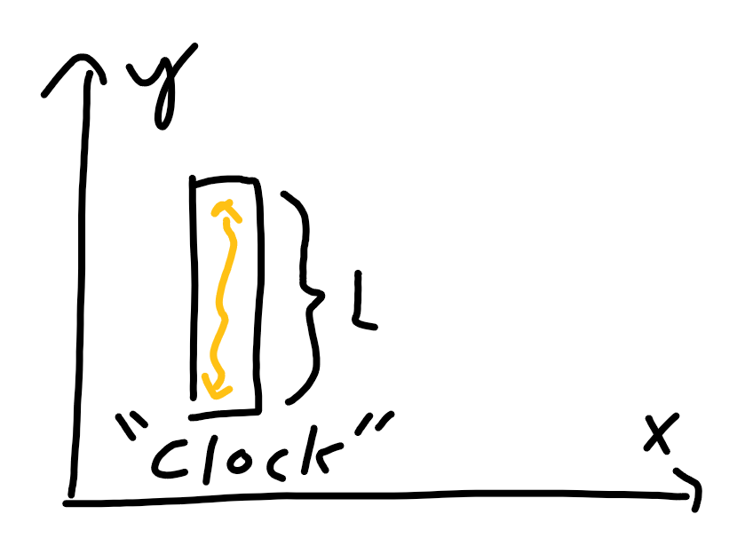
Light clock
Let us define a clock of a constant length L and a light beam bouncing up and down along the y-axis.
Since the speed of light is constant, we can change the length of the clock so it takes light one second to go from the bottom to the top.
But what if we put this clock on a spaceship moving at a constant velocity v?

Slide 16
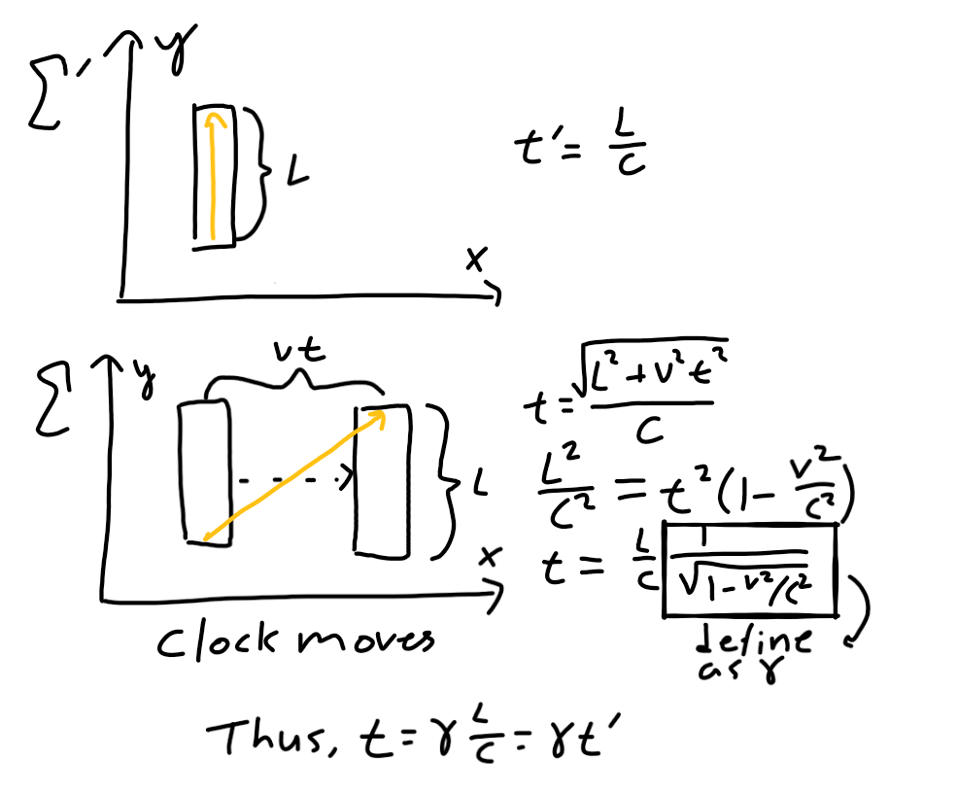
Time dilation
In the Σ’ (spaceship) system, the light beam still seems to go straight from the bottom of the clock to the top.
However, in the Σ (stationary) system, the light beam travels a further distance.
Thus, the stationary observer thinks more time passed compared to the spaceship observer.
The relationship can be written as t = γt’ where t’ is time passed through the spaceship system and t is time passed in the stationary system. Sometimes t and t’ are defined oppositely.

Slide 17
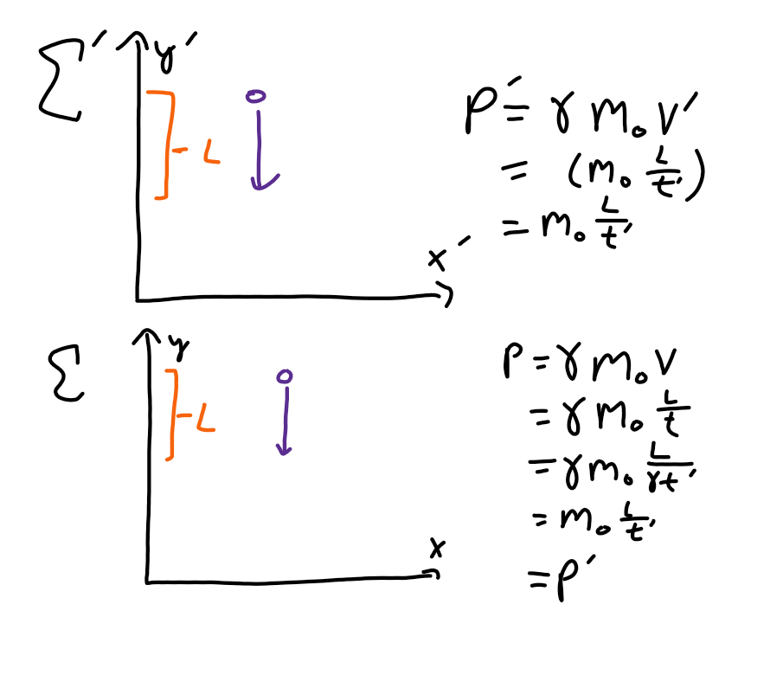
Relativistic momentum
Let us introduce a quantity called momentum, represented as p.
Momentum is generally calculated as mass times velocity, but in the relativistic sense, this is not true.
An object in different reference frames will have different momentums due to time dilation if we use p = mv, so we need a new momentum in relativity.
Relativistic momentum is defined as γm₀v.

Slide 18
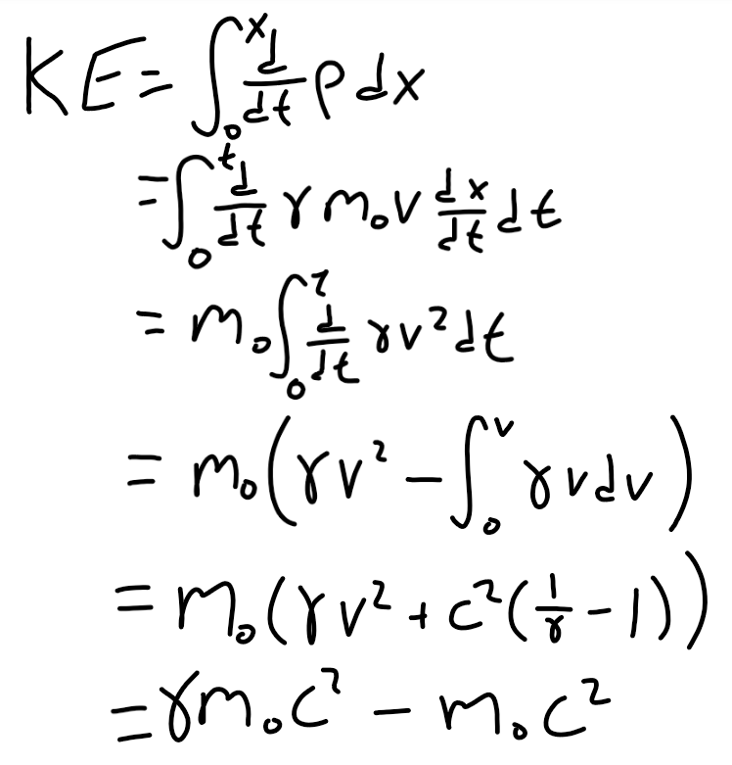
Relativistic kinetic energy
We can use some integration techniques to go from relativistic momentum to relativistic kinetic energy.
This gives us the formula KE = γm₀c² - m₀c².

Slide 19
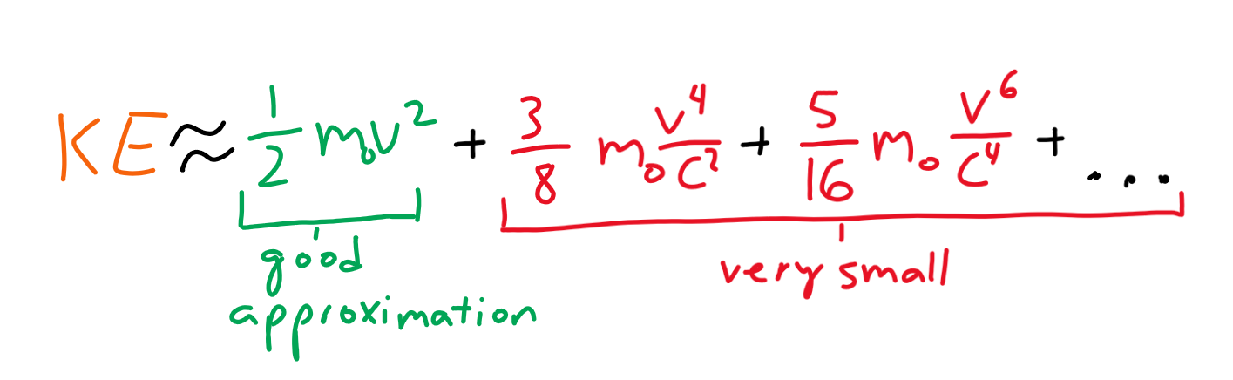
Taylor approximation of kinetic energy
Of course, we can try to Taylor approximate this kinetic energy to approximate the term γm₀c² ≈ m₀c²[1 + (1/2)(v²/c²) + (3/8)(v⁴/c⁴) + . . .].
For objects moving very slowly (v <<< c), then v⁴/c⁴ and subsequent terms disappear, giving us γm₀c² ≈ m₀c²[1 + (1/2)(v²/c²)].
Thus, KE = γm₀c² - m₀c² ≈ m₀c²(1/2)(v²/c²), which simplifies to KE ≈ (1/2)m₀v².

Slide 20
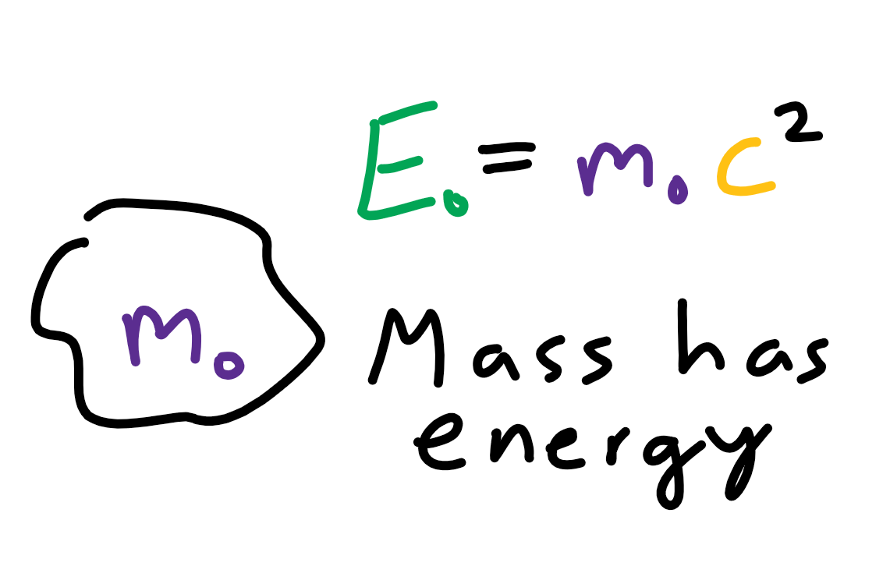
Einstein’s equation
E₀ = m₀c², but what does this really mean?
E₀ denotes the energy of an object at rest (the 0 represents that the object is moving at a velocity v = 0).
The mass of an object is m₀, and c is the speed of light. Thus, an object at rest intrinsically has energy due to its mass.
This is called mass-energy equivalence.

Slide 21
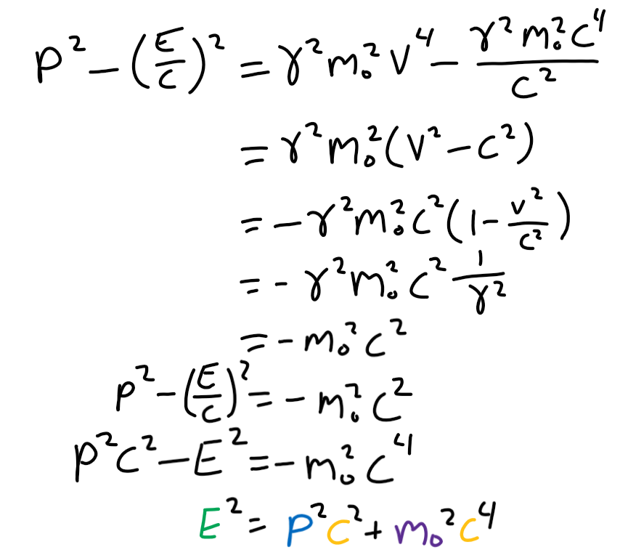
Relativistic energy
We can sum kinetic energy and the energy due to the mass of an object to get the total mass of an object.
Let relativistic momentum be p and relativistic energy be E. We can do some manipulation to get p² - (E/c)² = -m₀²c².
If we rearrange this, we get E² = p²c² + m₀²c⁴. This is the generalized form of Einstein’s equivalence principle for objects with velocity.

Slide 22
A “simple” question

Slide 23
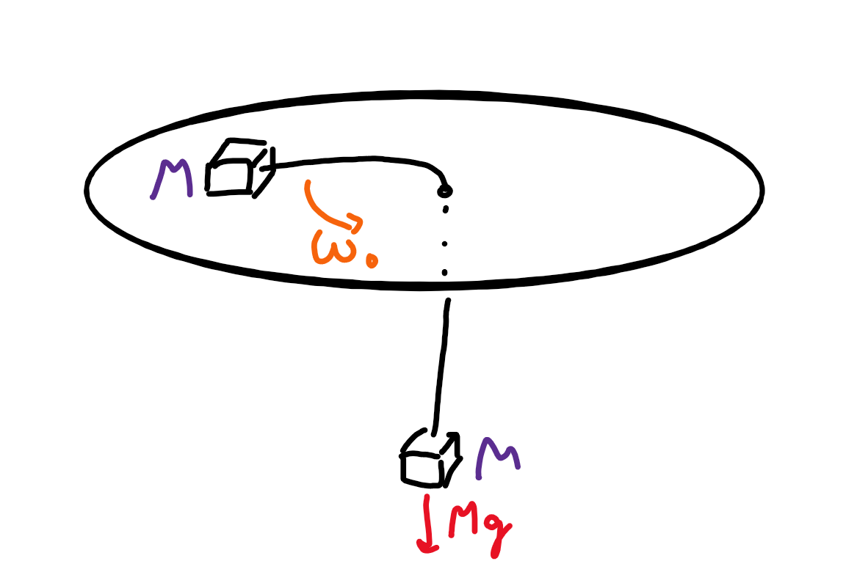
The “simple” question
Let a block of mass M on a circular table be connected by a string by a block also of mass M hanging under the center of the table.
At first, let the block on the table be spinning at a constant angular velocity ω₀ such that the spinning of the block counteracts the force of gravity (F_{a} = Mg) applied by the hanging block.
Now let’s give the spinning block a little push into the center of the table. What is the subsequent motion of the block?

